Slide 1
Bacchus Winery
Team Beast - Timmy Bell, Anh Vo, Julia Pope, Jared Olson

Slide 2
Case Study Description
Stan and Davis Bacchus, owners of a winery, are anxious to incorporate new business methods to help them improve their products and customer service. Stan and Davis are responsible for keeping track of the supply inventory and would like to find a more efficient method of keeping track and ordering supplies, perhaps over the internet. Maria, who is responsible for distribution, would like their distributors to be able to order online, and to be able to track shipments. Stan and Davis know the yearly ‘snapshot’ of the business is due in a few weeks, and need the information to determine the state of the inventory, the distribution and the employees.
They need information on…
- Are all suppliers delivering on time? Is there a large gap between expected delivery and actual delivery? A month by month report should show problem areas.
- The wine distribution, are all wines selling as they thought? Is one wine not selling? Which distributor carries which wine?
- Employee time. During the last four quarters, how many hours did each employee work?

Slide 3
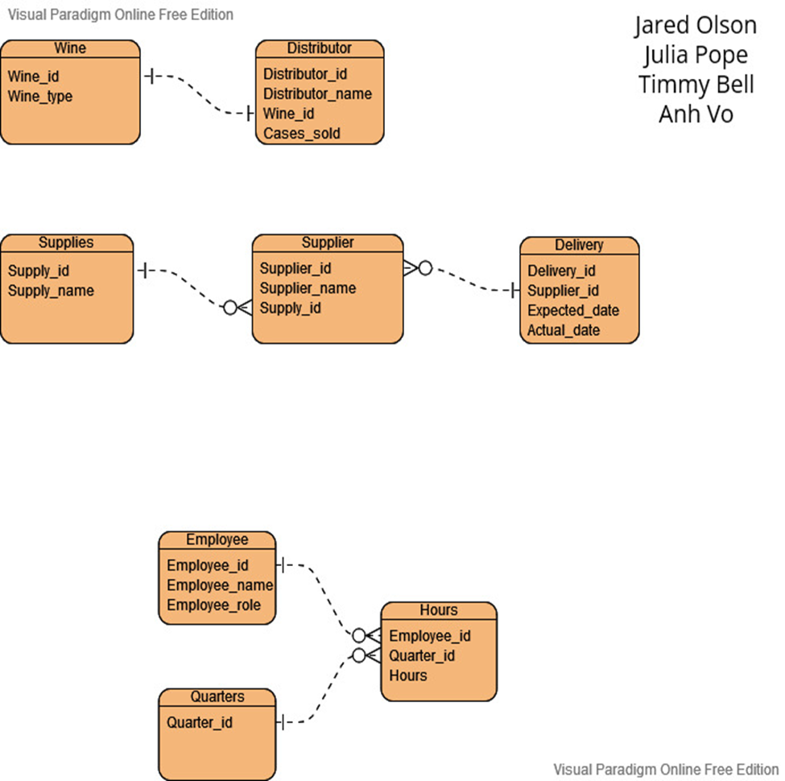
ERD

Slide 4
Business Rules
A supplier can deliver more than one supply, but a supply can only come from one supplier.
Each wine can only be distributed by one distributor per contract.
A distributor can only offer one specific wine.
A supplier can have many deliveries, but a delivery can only have one supplier.

Slide 5
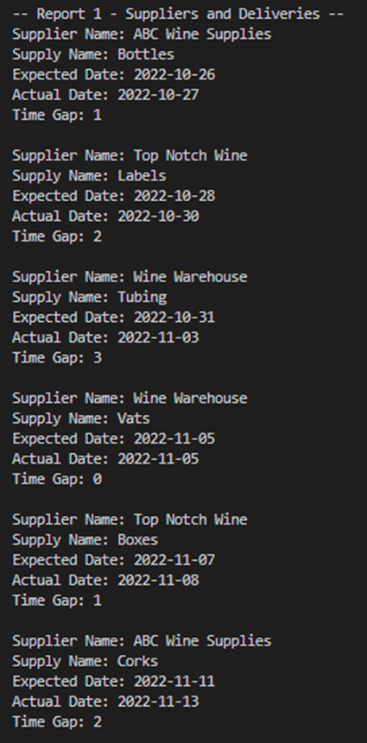
Report 1
Report #1 is a list of deliveries with the suppliers and dates of expected and actual delivery dates of supplies. This report lists what the time gap is between the two dates and gives the winery an idea if our supplies are arriving in a timely manner. This report is grouped by month with individual records falling in chronological order.

Slide 6
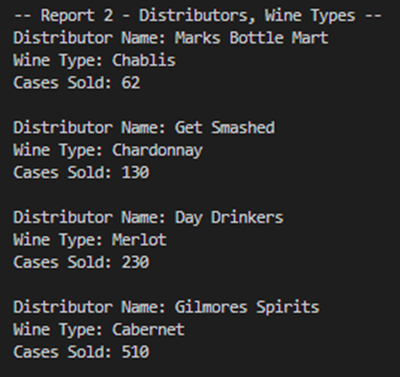
Report 2
Report #2 is a list of information about the distributors and wine types. The name of the distributor and the wine type supplied by that distributor are two of the three columns displayed here, and the other is the number of cases sold for each distributor and wine type. The results are ordered by the number of cases sold, so the wine being sold the least will appear at the top of the results.

Slide 7
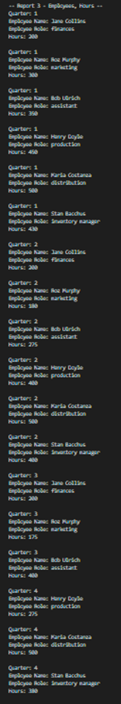
Report 3
Report #3 is a report of employee hours worked listed by quarters. This supplies the winery with a quarterly list of who is putting in the hours needed for purposes of possible bonuses based on contribution level.

Slide 8
Assumptions
Stan and Davis Bacchus want to keep track of the cumulative total of each wine ordered throughout all four quarters instead of the amount during each quarter.
All supply orders have the same quantities.

